Slide 1
Managing the Written Examination

Slide 2
Learning Objectives
At the end of the session, you will be able to:
  Describe the different written examination tools
  Understand the purpose of the written examination tools
  Understand how to grade the written examination

Slide 3
Written Examination
Area code | Content Area | Description | Number of questions | Examination Percentage
1 | Overview of Quality Assurance | Basic principles and practices of quality implemented in HIV rapid test setting | 3 | 12%
2 | Overview HIV Rapid Test | Basic knowledge pertaining to HIV and HIV rapid testing | 3 | 12%
3 | Safety | Safety measures and practices implemented in HIV rapid testing setting | 3 | 12%
4 | Specimen Collection | Processes related to the Collection Specimens specifically for HIV rapid testing | 2 | 8%
5 | HIV Testing Algorithm | Sequence in which HIV Rapid Testing is performed | 3 | 12%
6 | Record keeping /Documentation | Methods used to create, capture, maintain, and dispose of HIV rapid test data. | 3 | 12%
7 | External Quality Assessment/ Proficiency testing | System used for objectively review the testing site operation and performance using an external organization | 4 | 16%
8 | Professional Ethics | Personnel, organizational, and corporate standards of behavior expected by HIV rapid test professionals | 2 | 8%
9 | Inventory | Monitoring and control of commodity pertaining to HIV rapid testing | 2 | 8%
Examination Model
25 questions over 1 hr. exam time
Content covers 9 testing topic areas
Each content area comprises a specific percentage of the 25-question exam.
Question bank with 170 questions

Slide 4
Steps for Generating Written Exam Questions
1. Create set of 25 question codes using the Random Question Generator
2. Transfer the question codes generated to the Question Tracker Sheet
4. Transfer the matching questions to the Written Examination Questions Template and Answer key
3. Select the matching questions from the Question Bank created
5. Print the Written Examination Questions with the Examination Sheet for each exam to be administered and separately, the Answer Key for the Evaluator

Slide 5
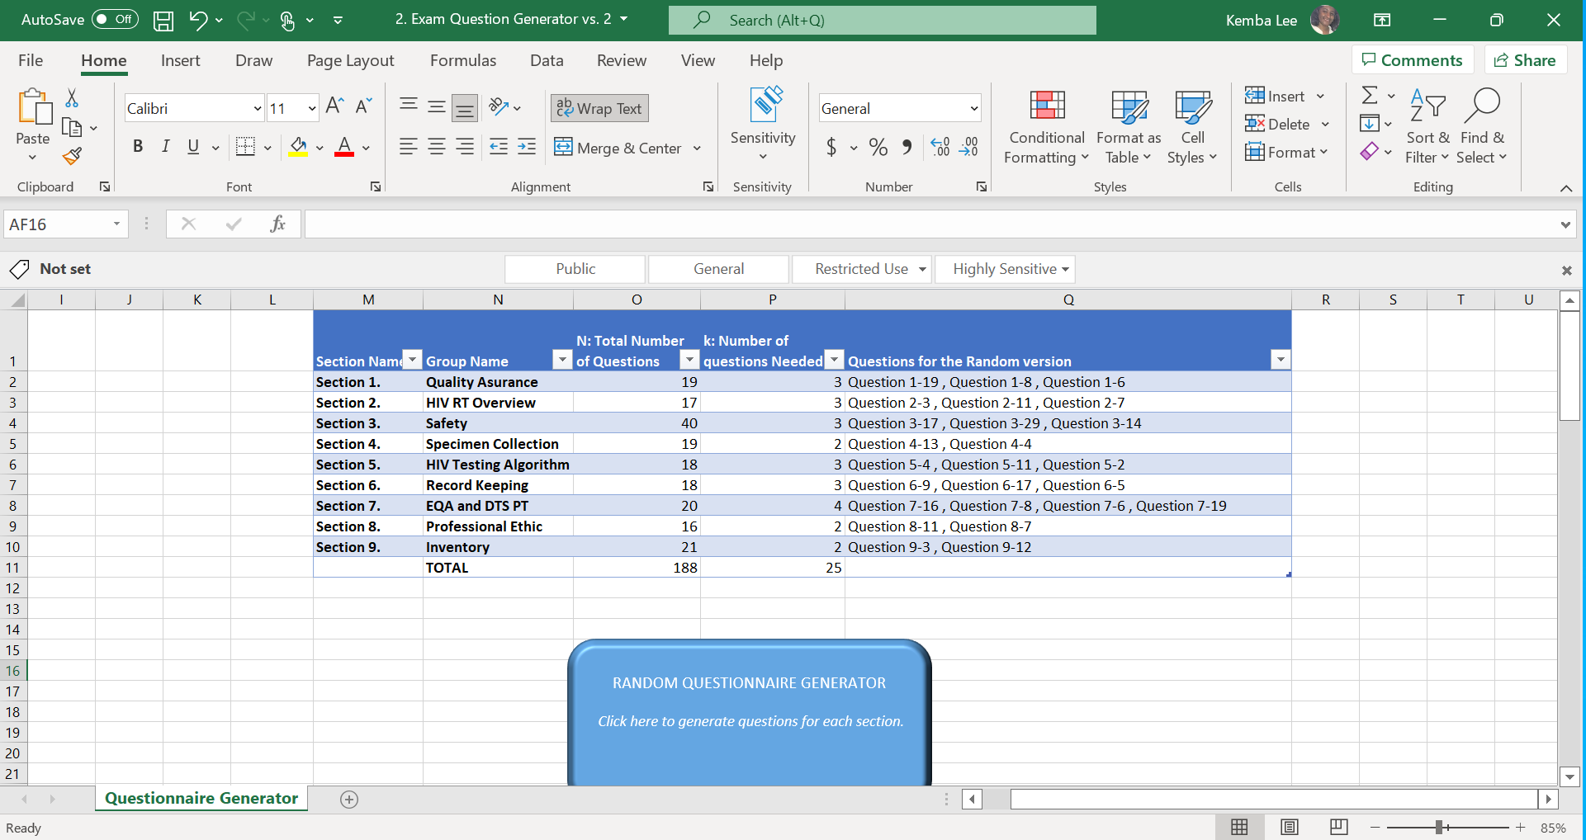
Step 1. Create 25 question codes using the
Exam Question Generator

Slide 6
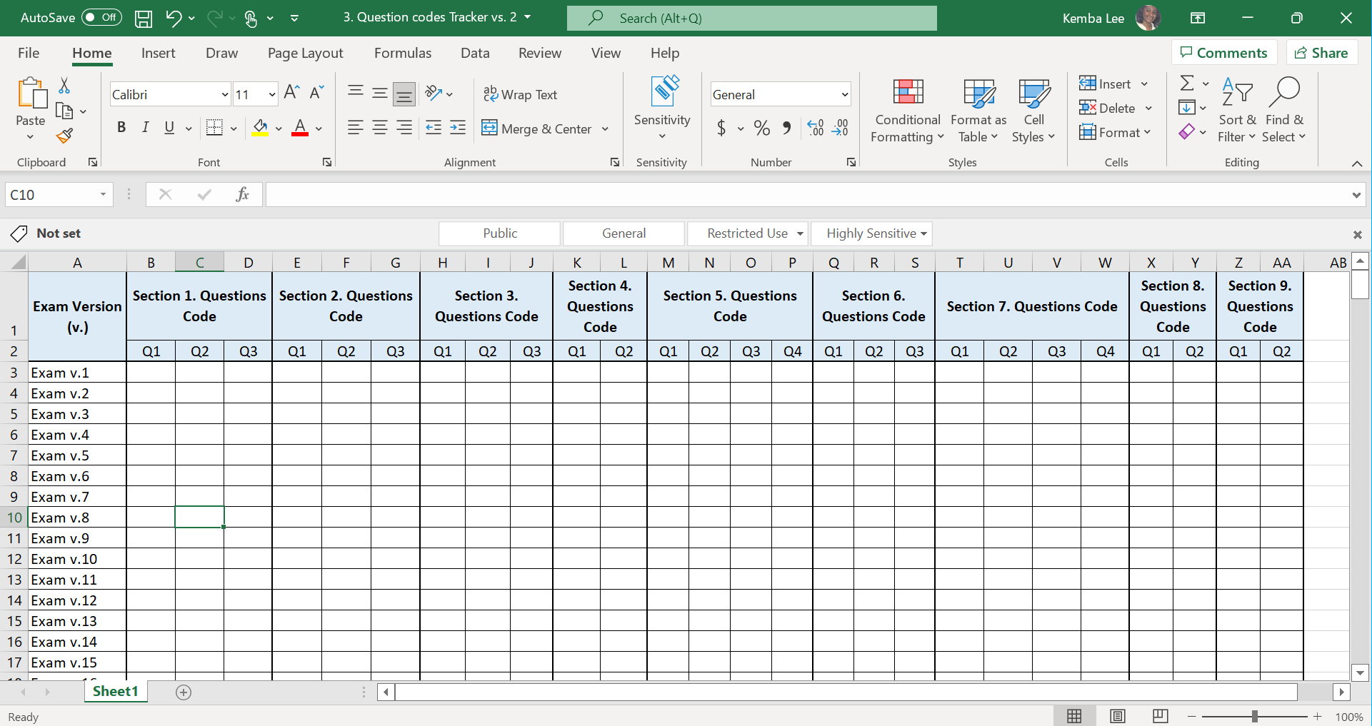
Step 2. Transfer the question codes to the
Question Codes Tracker

Slide 7
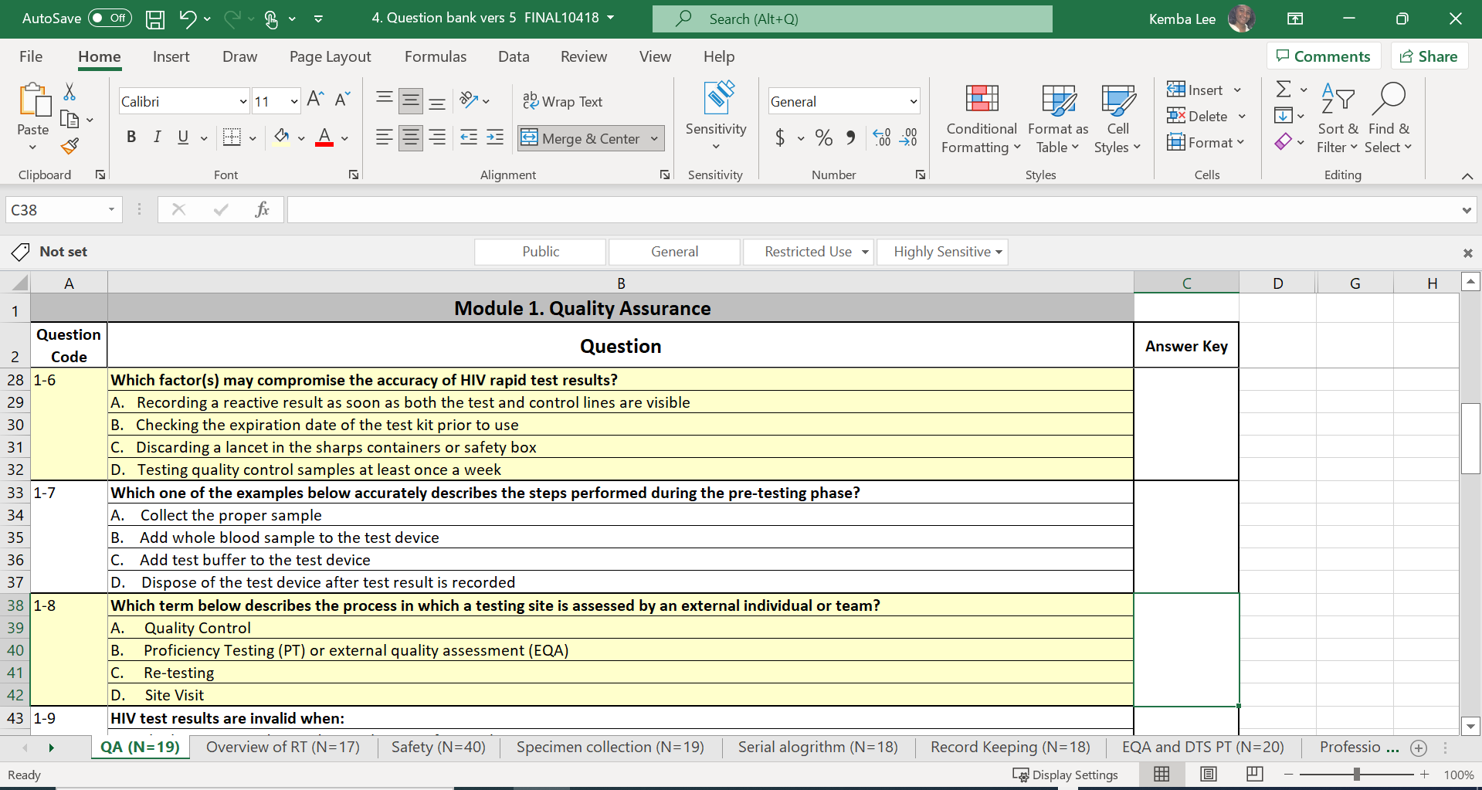
Step 3. Select the matching questions from the
Question Bank

Slide 8


Step 4. Transfer the Matching Questions to the
Written Examination Question Template and Answer Key

Slide 9

5. Creating Written Examination Packet for the Evaluator
Packet to Distribute to Examinees
Registration sheet
Written Examination Questions
Written Examination Sheet
Written Examination Answer Key
(only 1 for the Evaluator)

Slide 10
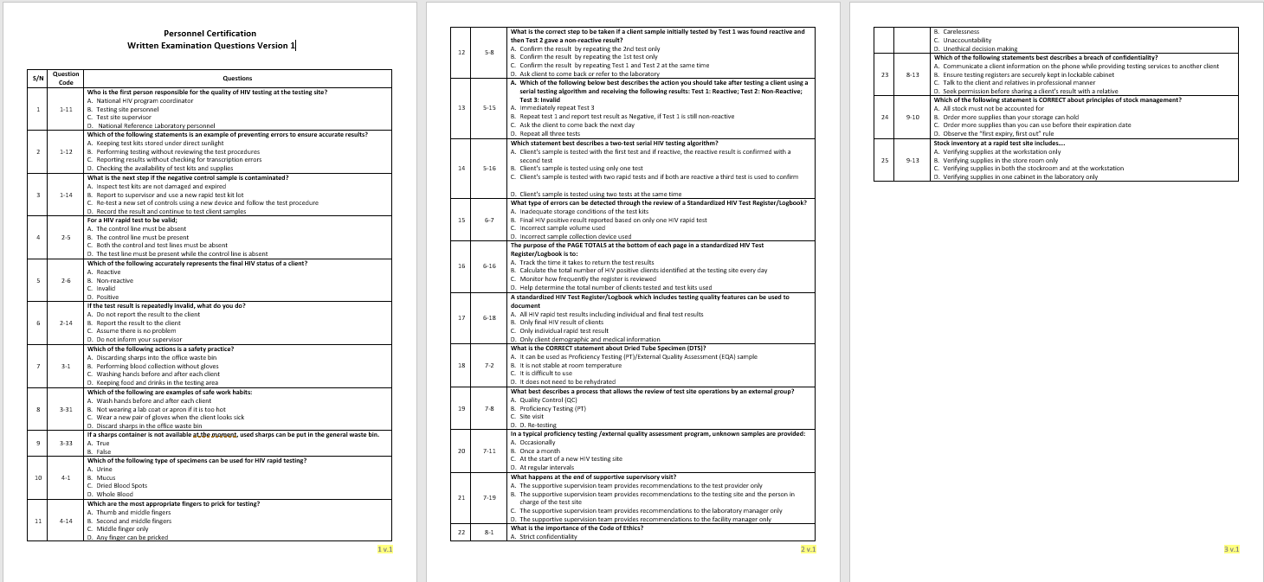
Written Examination Question Handout
Suggest no phones allowed
Do not write on handout.
Collect after the Examinee finishes the exam.

Slide 11
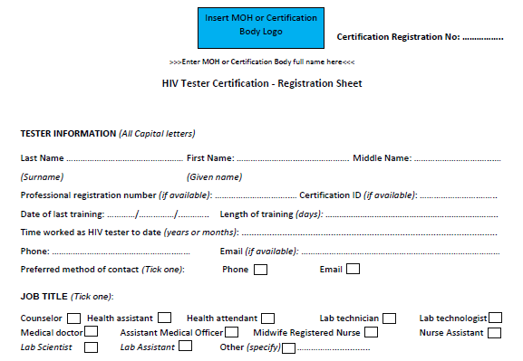
Registration Sheet (1)

Slide 12
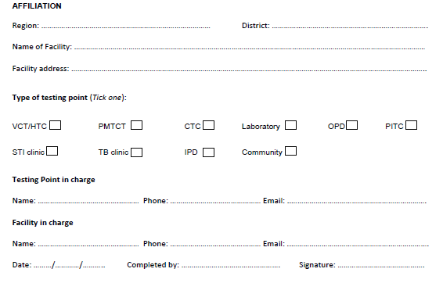
Registration Sheet (2)

Slide 13
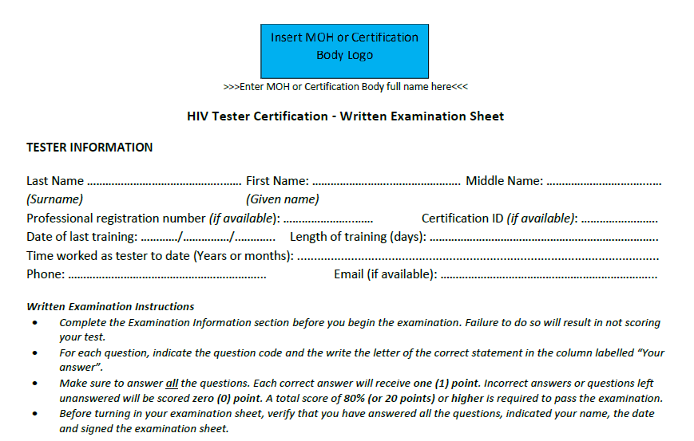
Written Examination Sheet (1)

Slide 14

Examinee Completing the Written Examination Sheet (2)

Slide 15
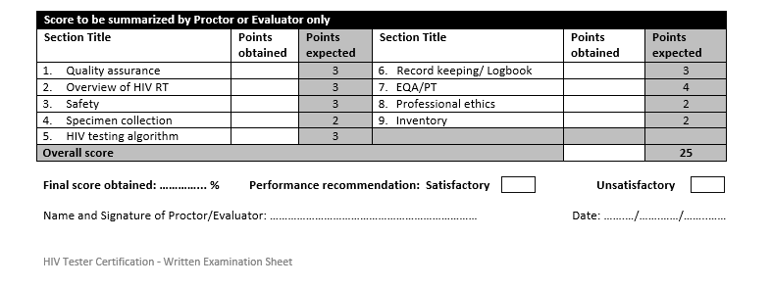
Examiner Completing the Written Examination Sheet (3)

Slide 16
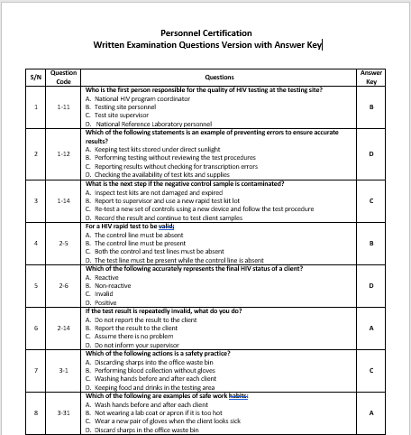
Written Examination Questions with Answer Key for Evaluator

Slide 17
Roles and Responsibility
Tools | Tester | Evaluator/ Proctor
Registration Sheet
Written Examination Questions Handout
Written Examination Question version with Answer key
Examination Sheet
Complete or
Review and sign
Complete
Use as resource during the examination
Keep before and after examination
Use to grade examination
DOES NOT NEED
Use to record exam answer
Review and grade

Slide 18
Roles and Responsibility
Tools | Tester | Evaluator/ Proctor
Registration Sheet | Complete | Review and sign
Written Examination Question version | Use as resource during the examination | Keep before and after examination
Written Examination Question version with Answer key | DOES NOT NEED | Use to grade examination
Examination Result form | Use to record exam answer | Review and grade

Slide 19
Summary
What are the different written examination tools?
Who uses the Written examination question version
Who uses the Written examination question version with answer key?
How is the written examination graded?

